Slide 1
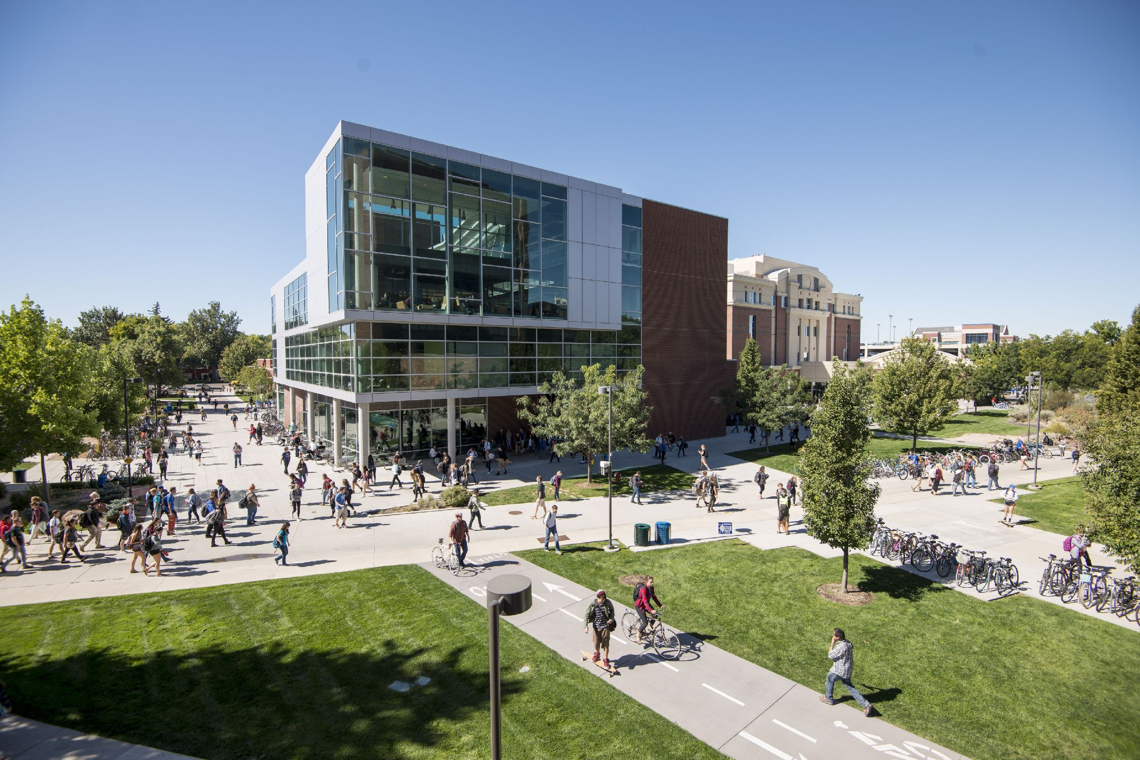

Reproducible Prediction Of Organic Semiconductor Properties Through Open-Source Software Development
June 9, 2022
Jimmy Rushing
Notes:
Thank you Dr. Jankowski and thanks you everyone for coming. Today I am going to talk about some work that we have been doing on our software for simulating organic semiconductors.
The unique properties of organic semiconductors make them ideal candidates for many electronic applications. They are used today in ultra high resolution Organic Light Emitting Diode (OLED) TVs and cellphone displays. They enable foldable OLED screens and rollable TVs [? ]. Organic semiconductors are also integral to the design of next generation medical devices owing to their self-healing properties and their biodegradability [? ].

Slide 2
Talk Outline
Organic Solar cells and Organic photovoltaics background
Methods of simulating self-assembly and charge transport
Software development for simulating charge transport
Notes:
OUTLINE OF TALK:
In this talk I am going to discuss a subclass of organic semiconductors, Organic Photovoltaic (OPV) materials, and their use in the active layer of Organic Solar Cell (OSC) devices. To begin, I am going give a brief background on OSCs and introduce the specific OPVs that I am going to discuss today.
I am then going to introduce our methods involved in simulating the self assembly and charge transport of opvs as well as the software packages that we develop for the execution of these methods.
Finally, I am going to talk about some of the specifics of the development that we have done on our software package for simulating charge transport.

Slide 3
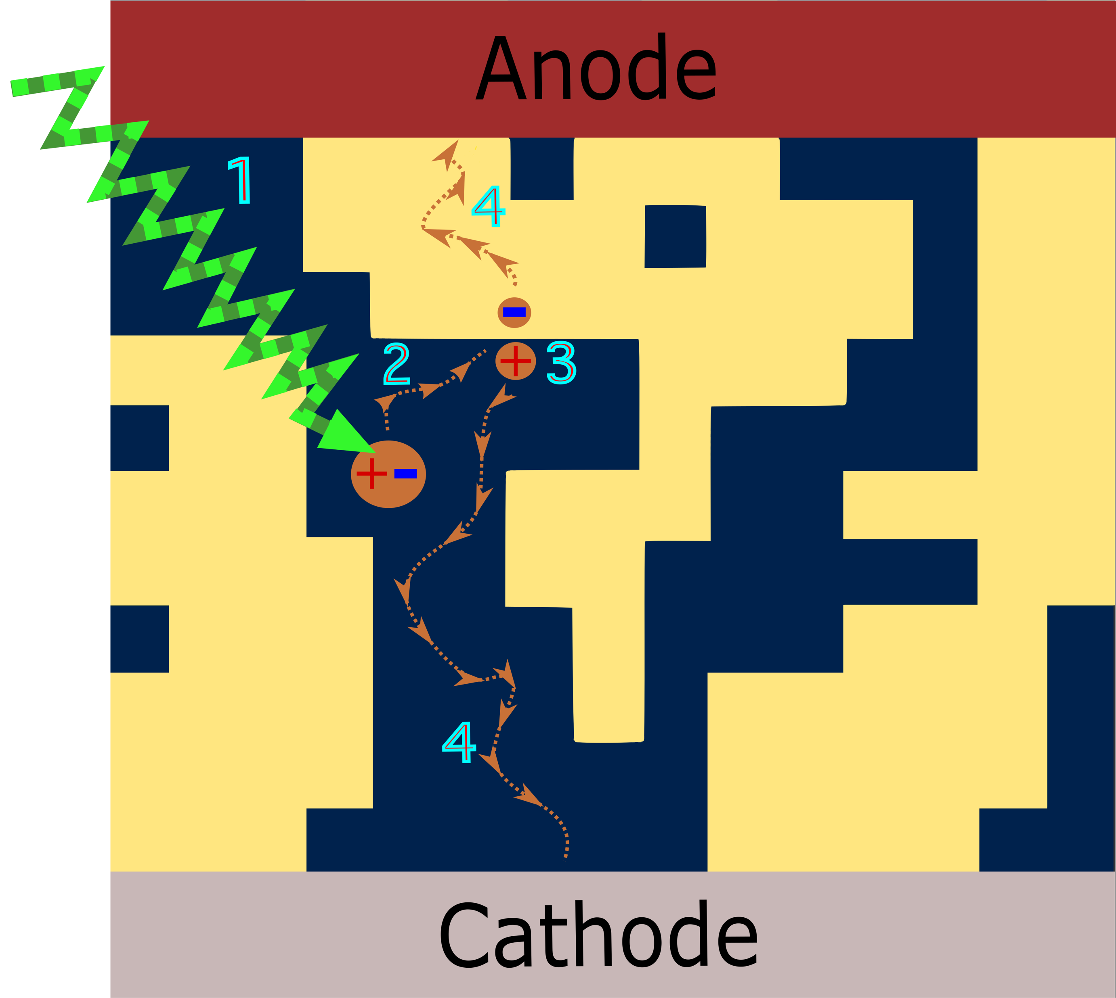
Bulk-heterojunction Device
Notes:
A simple model for OSCs is that they are OLEDs working in reverse, absorbing photons and generating current rather than converting current into light.
We see yellow acceptor material suspended in a matrix of donor material in blue.
The photon (green arrow) interacts with the material, exciting an electron and creating a quasiparticle referred to as an exciton.
The exciton diffuses about until it intersects the interface between donor and acceptor material domains.
The exciton is coerced apart by the energy offset between donor and acceptor molecules.
The, now unbound, hole and the electron are free to diffuse about until they reach their respective electrodes where they can be extracted.
We are going talk about how we can simulate stage 4. That is electron diffusion in acceptor material and holes diffusion in donor material.

Slide 4
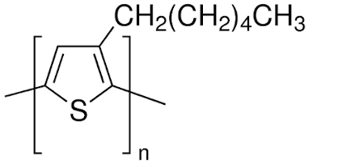
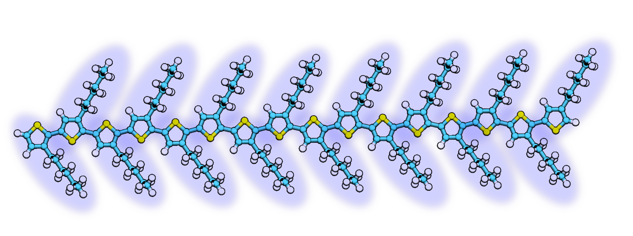
Polymeric Donors
P3HT
Notes:
The acceptor that we are going to simulate if ITIC.

Slide 5
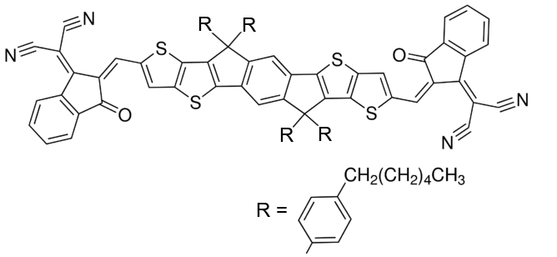
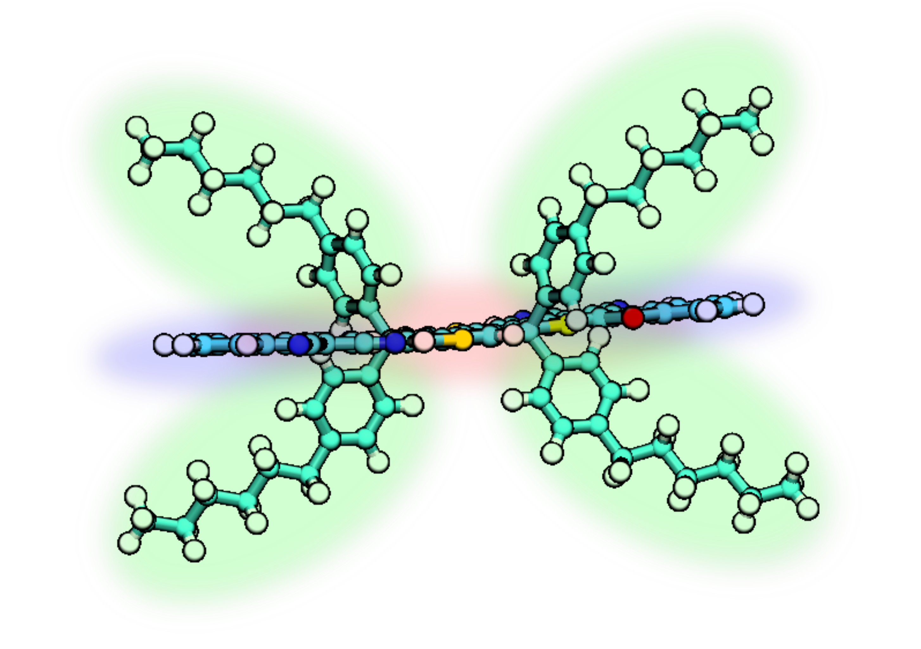
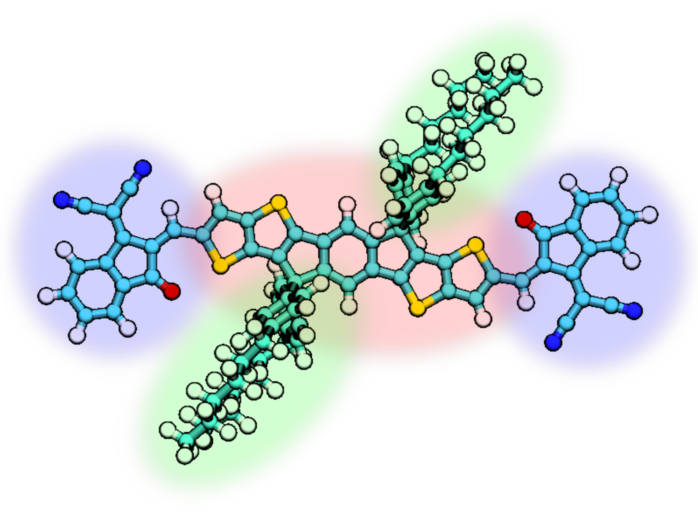
Fused-ring Electron Acceptors
ITIC
Notes:
The acceptor that we are going to simulate if ITIC.

Slide 6
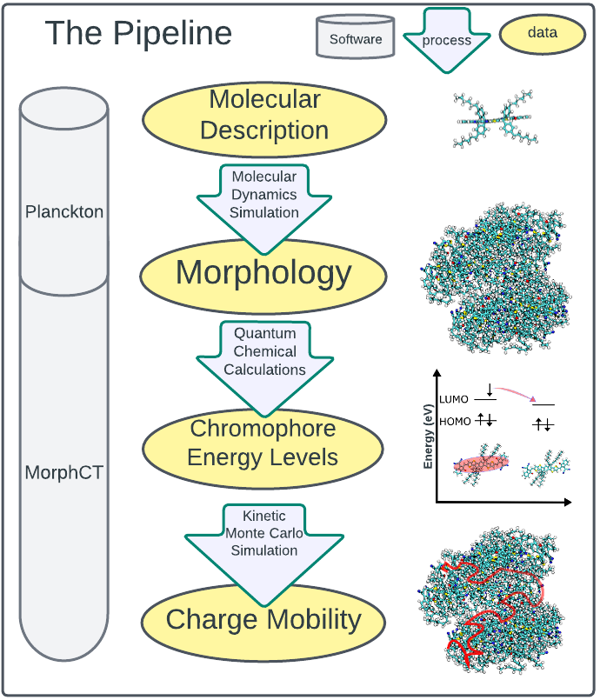
Notes:
Here we have the data pipeline through which we can take an atomistic representation of a material and graduate that iteratively to macroscopic material properties.

Slide 7
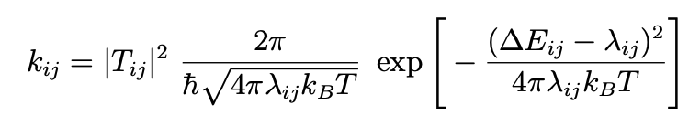
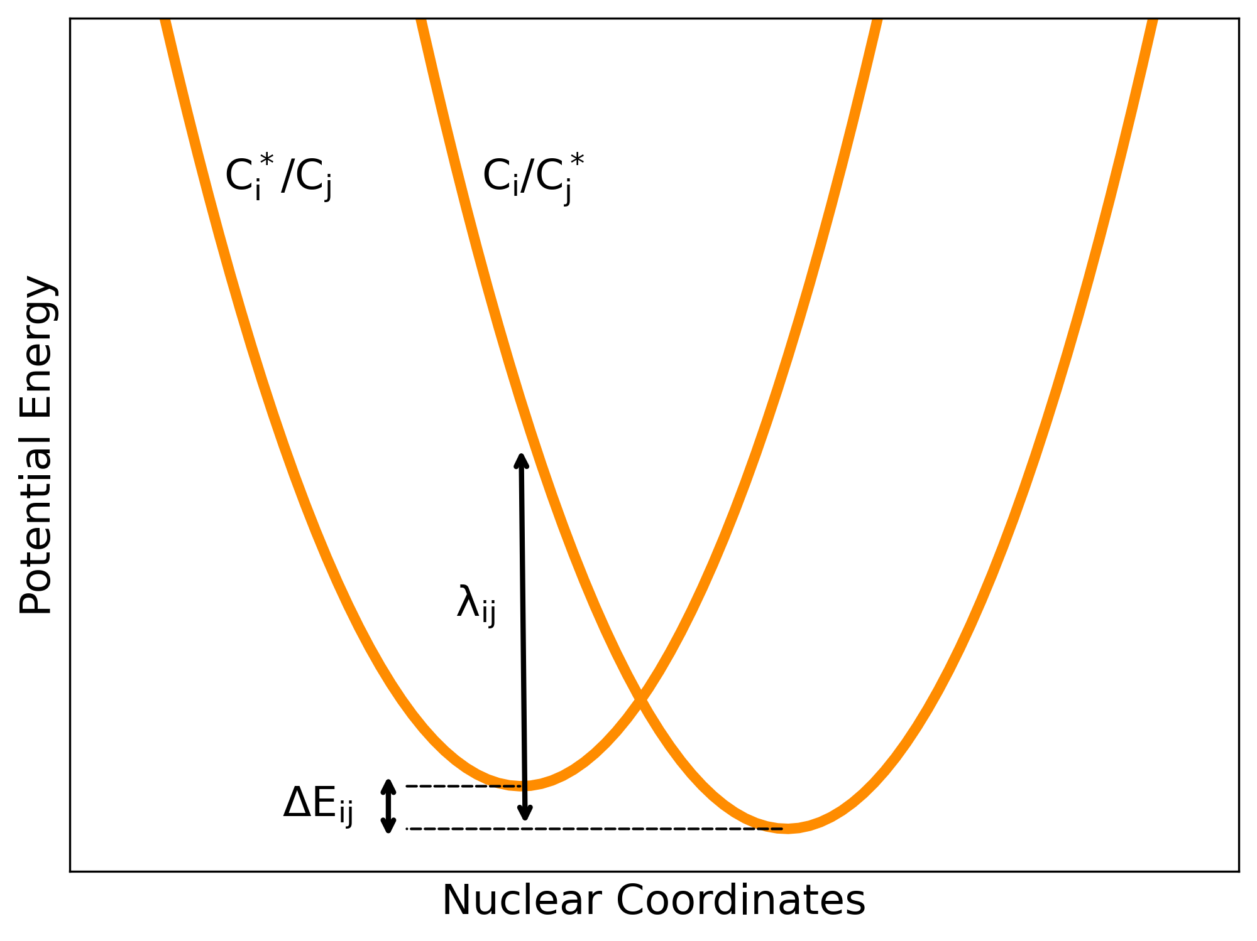
Marcus Theory gives the rate of electron transfer reactions or “hops” between chromophores
v
Notes:
The movement of a free charge through a morphology can be modeled as a series of Marcus nonadiabatic electron transfer reactions, or ‘hops’ between relatively weakly interacting chromophores in the system.
Boltzmann’s constant, kB, and Planck’s constant, h ̄. The parameters Tij, λij, ∆Eij, T represent the electronic overlap, the reorganization energy, the free energy
16 difference between chromophores, and temperature.
From this description of all possible hops in the system we can use a kinetic monte carlo algorithm to arrive at a charge mobility calculation.

Slide 8
Kinetic Monte Carlo algorithm based on the Marcus rates
Implant a charge in a random chromophore
Create a queue of wait times (inverse of Marcus hop rate)
Shuffle the wait time of each hop in the queue by ln(1/x) where x is a randomly chosen number on the interval (0,1]
Continue until the charge hops past a predetermined amount of time
Repeat for 1000’s of carriers.
Notes:
A core tenet of Monte Carlo sampling is ensuring a large sample size. With a large enough sampling, significant reshuffling of the queue will take place, allowing for a rare hop to jump the queue. For example, a charge carrier that hopped a million times, and had exactly 5 neighbors at each hop, would require forming a million wait time queues and 5 million individual wait time calculations. Shuffling each wait time by ln (1/x), we can expect to see ∼50 wait times that have been shortened by 5 orders of magnitude, ∼500 shortened by 4 orders of magnitude, and so on.
So this can model an individual charge carriers movement through a morphology, but how do we aggregate this information statistically to arrive at a charge mobility predfiction?

Slide 9
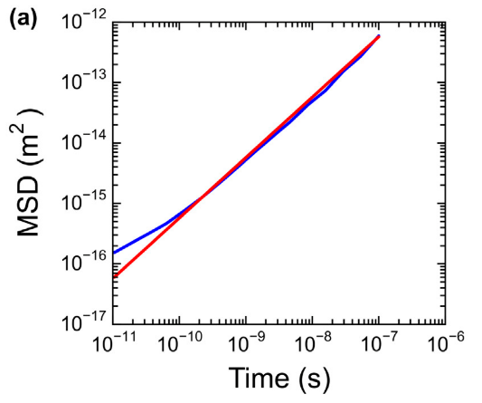
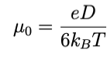
Analysis of Kinetic Monte Carlo Data
The diffusivity, D, of a free charge walking randomly through this electronic environment is given by the slope of the Mean Squared Displacement (MSD).
Charge mobility is then given by the following Einstein-Smoluchowski relation:
Jones, M. L., & Jankowski, E. (2017). Computationally connecting organic photovoltaic performance to atomistic arrangements and bulk morphology. Molecular Simulation, 43(10-11), 756–773. doi:10.1080/08927022.2017.1296958
Notes:
MSD is the standard deviation in position and the slope of MSD becomes linear as time goes to infinity.
There is no objective best practice for determining the slope of the MSD as time goes to infinity from simulation data of this kind [? ].

Slide 10
MorphCT
A package for running and analyzing KMC simulations
Replaced ORCA with PySCF for QCC
Validate that PySCF works at the chromophore level
Validate and perform sensitivity analysis using a benchmark P3HT morphology
Deploy the pipeline from scratch on ITIC
Development
Notes:
Remembering the pipeline, we are going to take a morphology that was provided by evan (list everyone) and jump into this stage

Slide 11
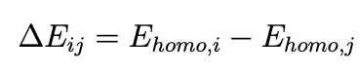
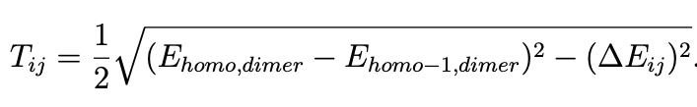
Quantum chemistry used to calculated two components of the Marcus hop rate.
Notes:
the values Ehomo,i and Ehomo,j represent the eigenvalues of the time-independent Shrodinger equation corresponding to the HOMOs of chromophore i and j respectively
In our work, these values are approximated with the MINDO/3 method, a variation of the intermediate neglect of differential overlap (INDO) method. This method seeks recreate the ab initio Hartree-Fock results, where Hatree-Fock theory allows for an iteratively convergent numerical solution to the Shrodinger equation [? ].

Slide 12
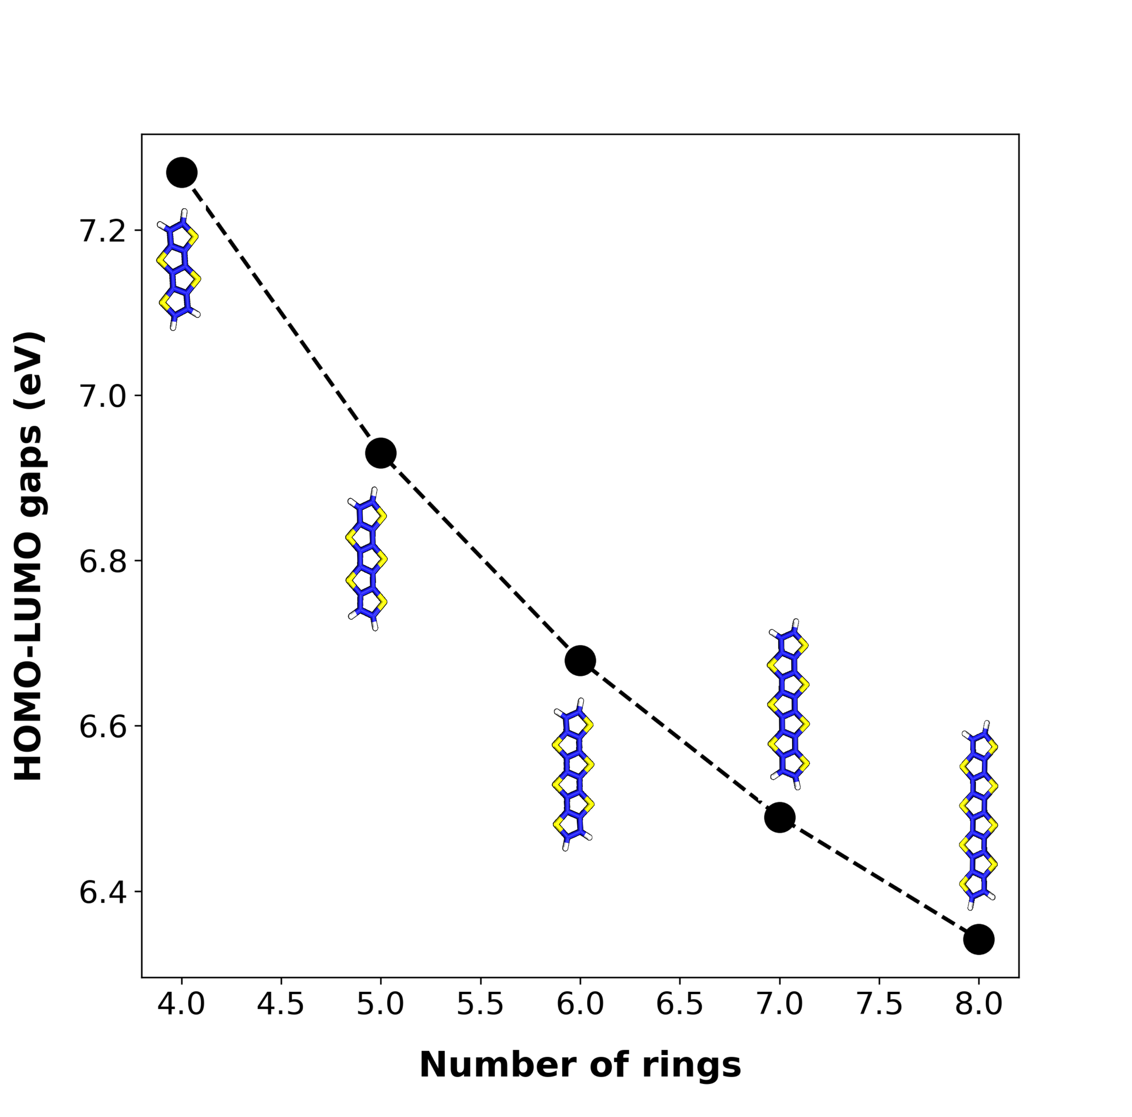
Notes:
HOMO-LUMO gaps obtained using MorphCT for fused-ring molecules of oligmer length 4 − 8.
ab initio DFT (between 5.26eV and 4.92eV ).

Slide 13
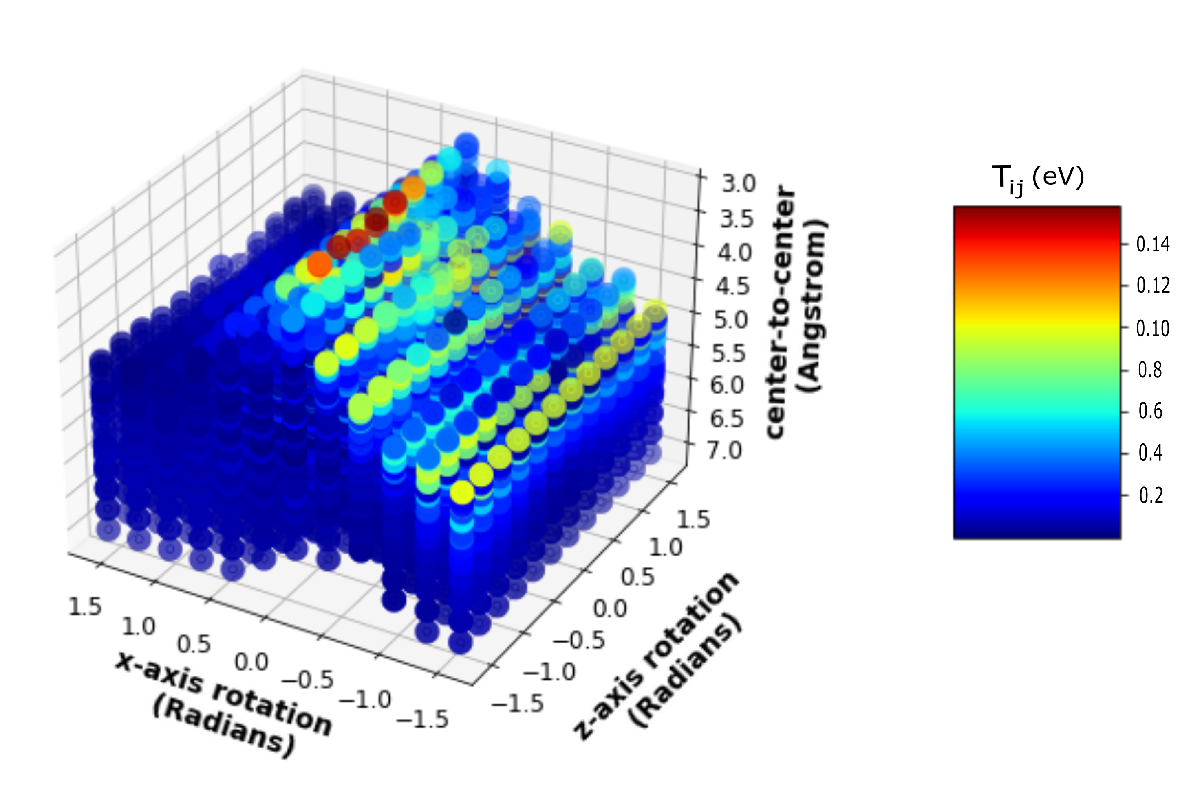
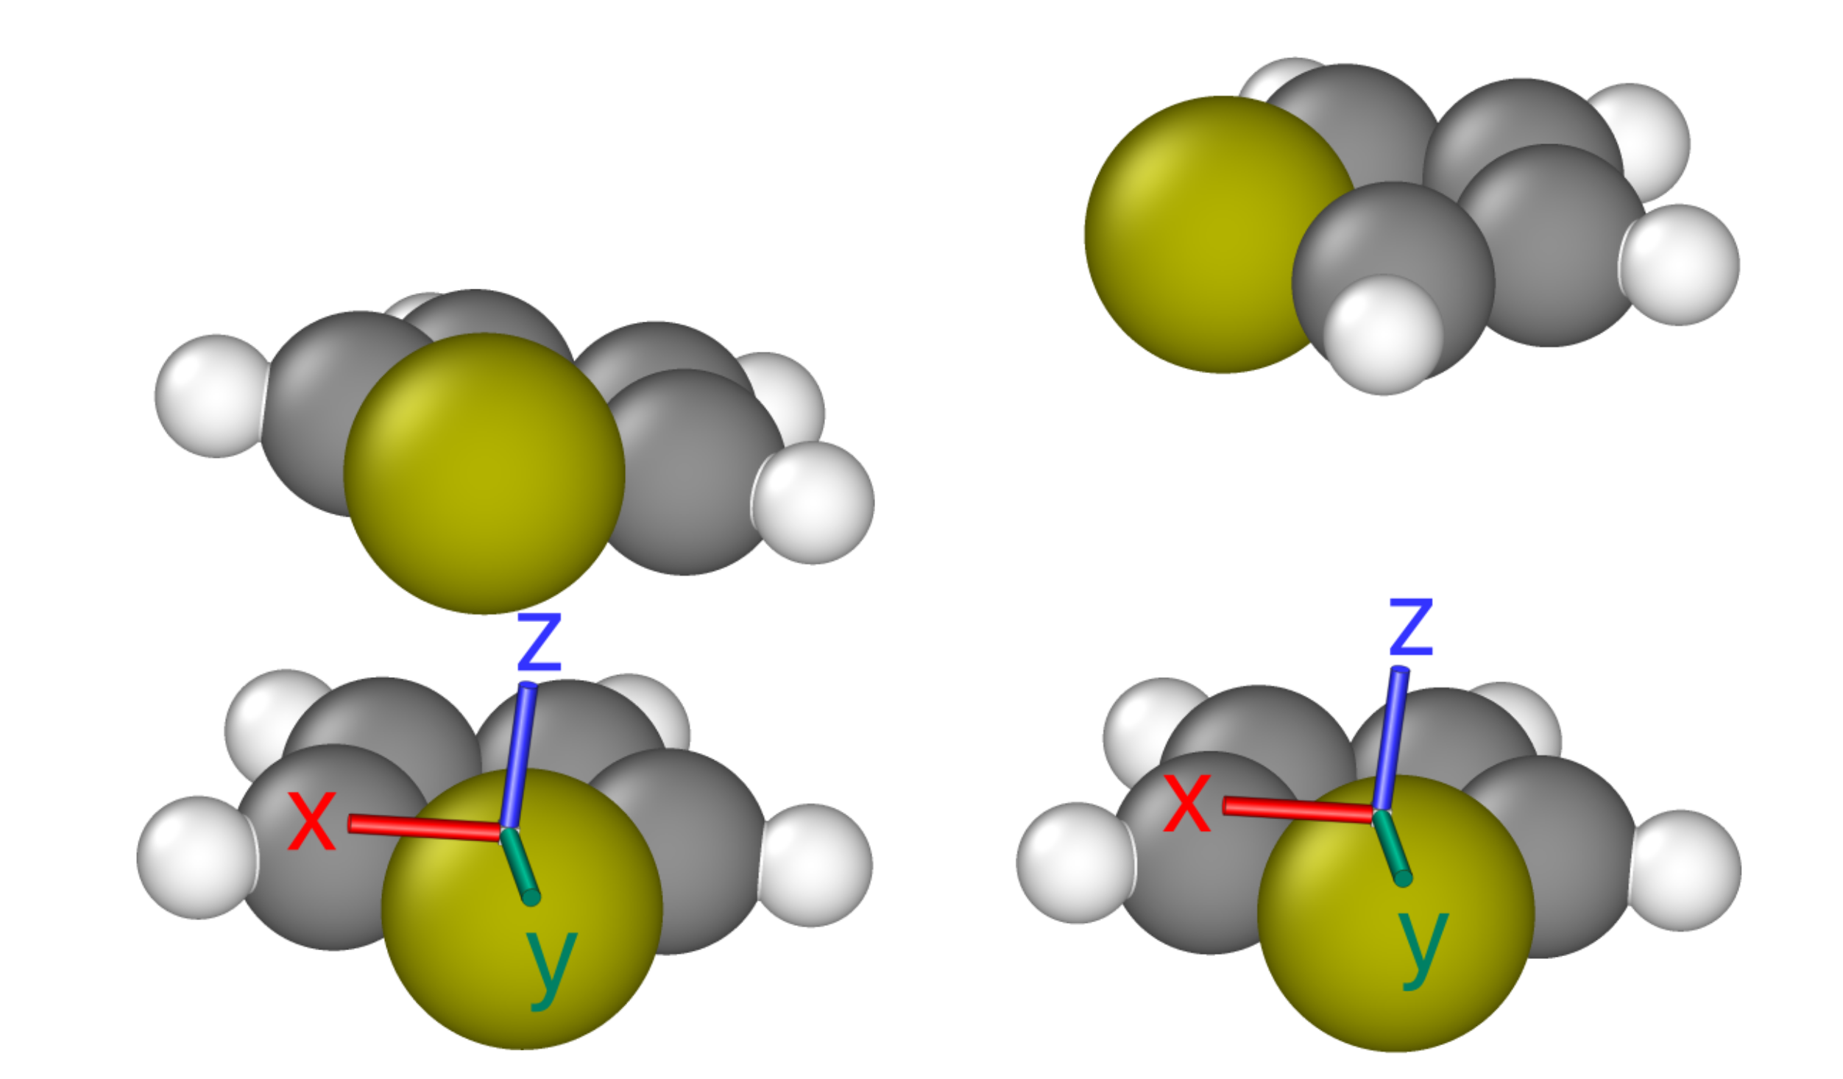
Notes:
(a) Individual dots correspond to 5680 distinct combinations of rotations and translations of the upper thiophene. Dots are colored based on the Tij between thiophenes for the given x-axis rotation, z-axis rotation, and center to center distance from the reference thiophene.
LEFT: The orientation (x-axis rotation ∼0.14, z-axis rotation ∼−0.14, center-to-center ∼3.2) with the hightest Tij. RIGHT: The orientation (x-axis rotation ∼ − 0.14, z-axis rotation ∼ − 1.5, center-to-center ∼5) with the lowest Tij.

Slide 14
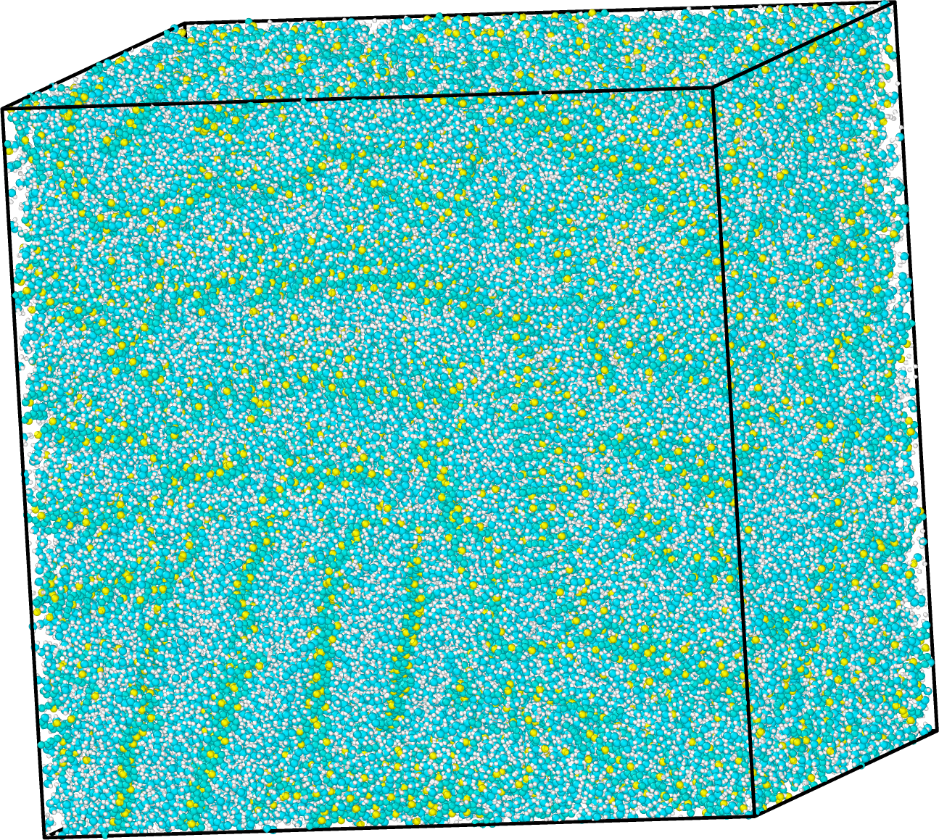
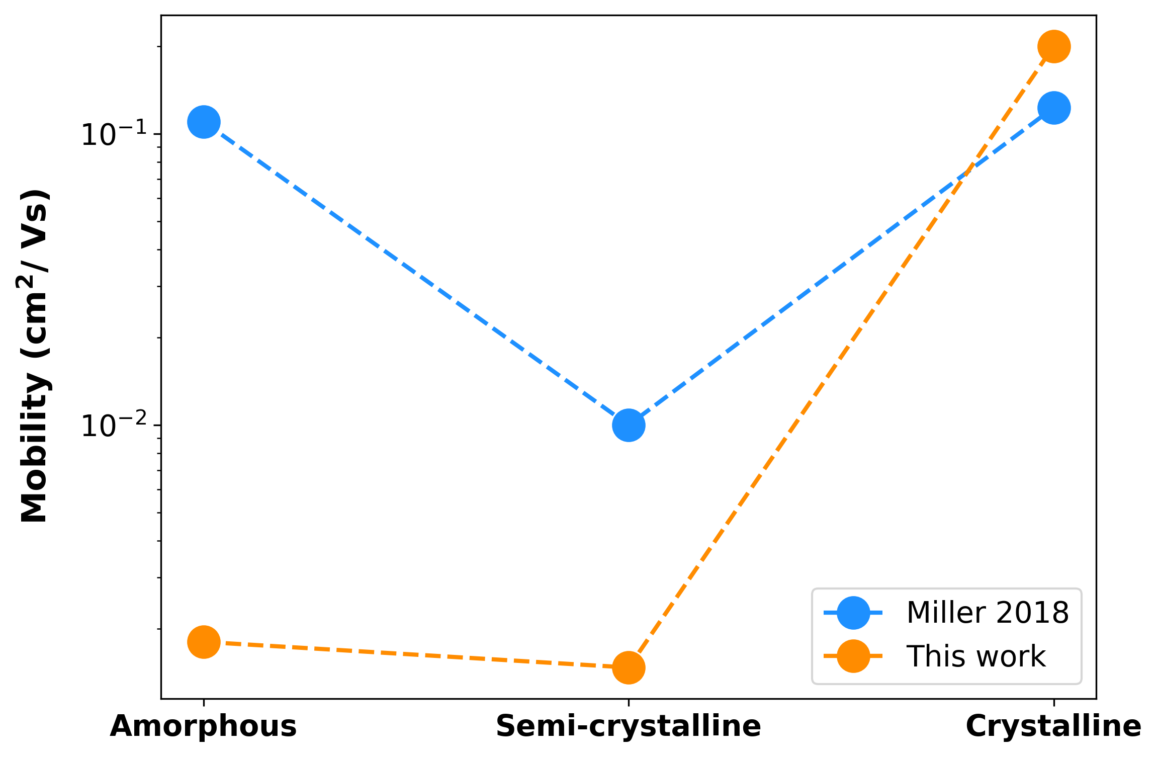
Notes:
10^-1 approaching band like transport speeds.
Need to do further validation to see how the trend matches with polydisperse morphology.

Slide 15
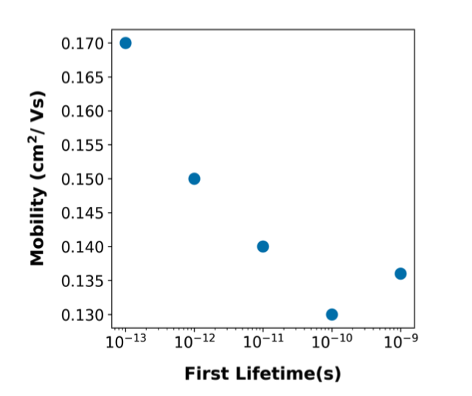
Jones, M. L., & Jankowski, E. (2017). Computationally connecting organic photovoltaic performance to atomistic arrangements and bulk morphology. Molecular Simulation, 43(10-11), 756–773. doi:10.1080/08927022.2017.1296958

Slide 16
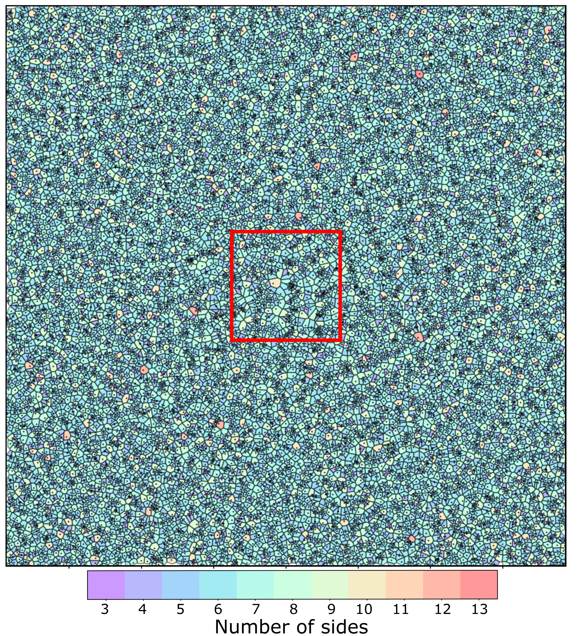
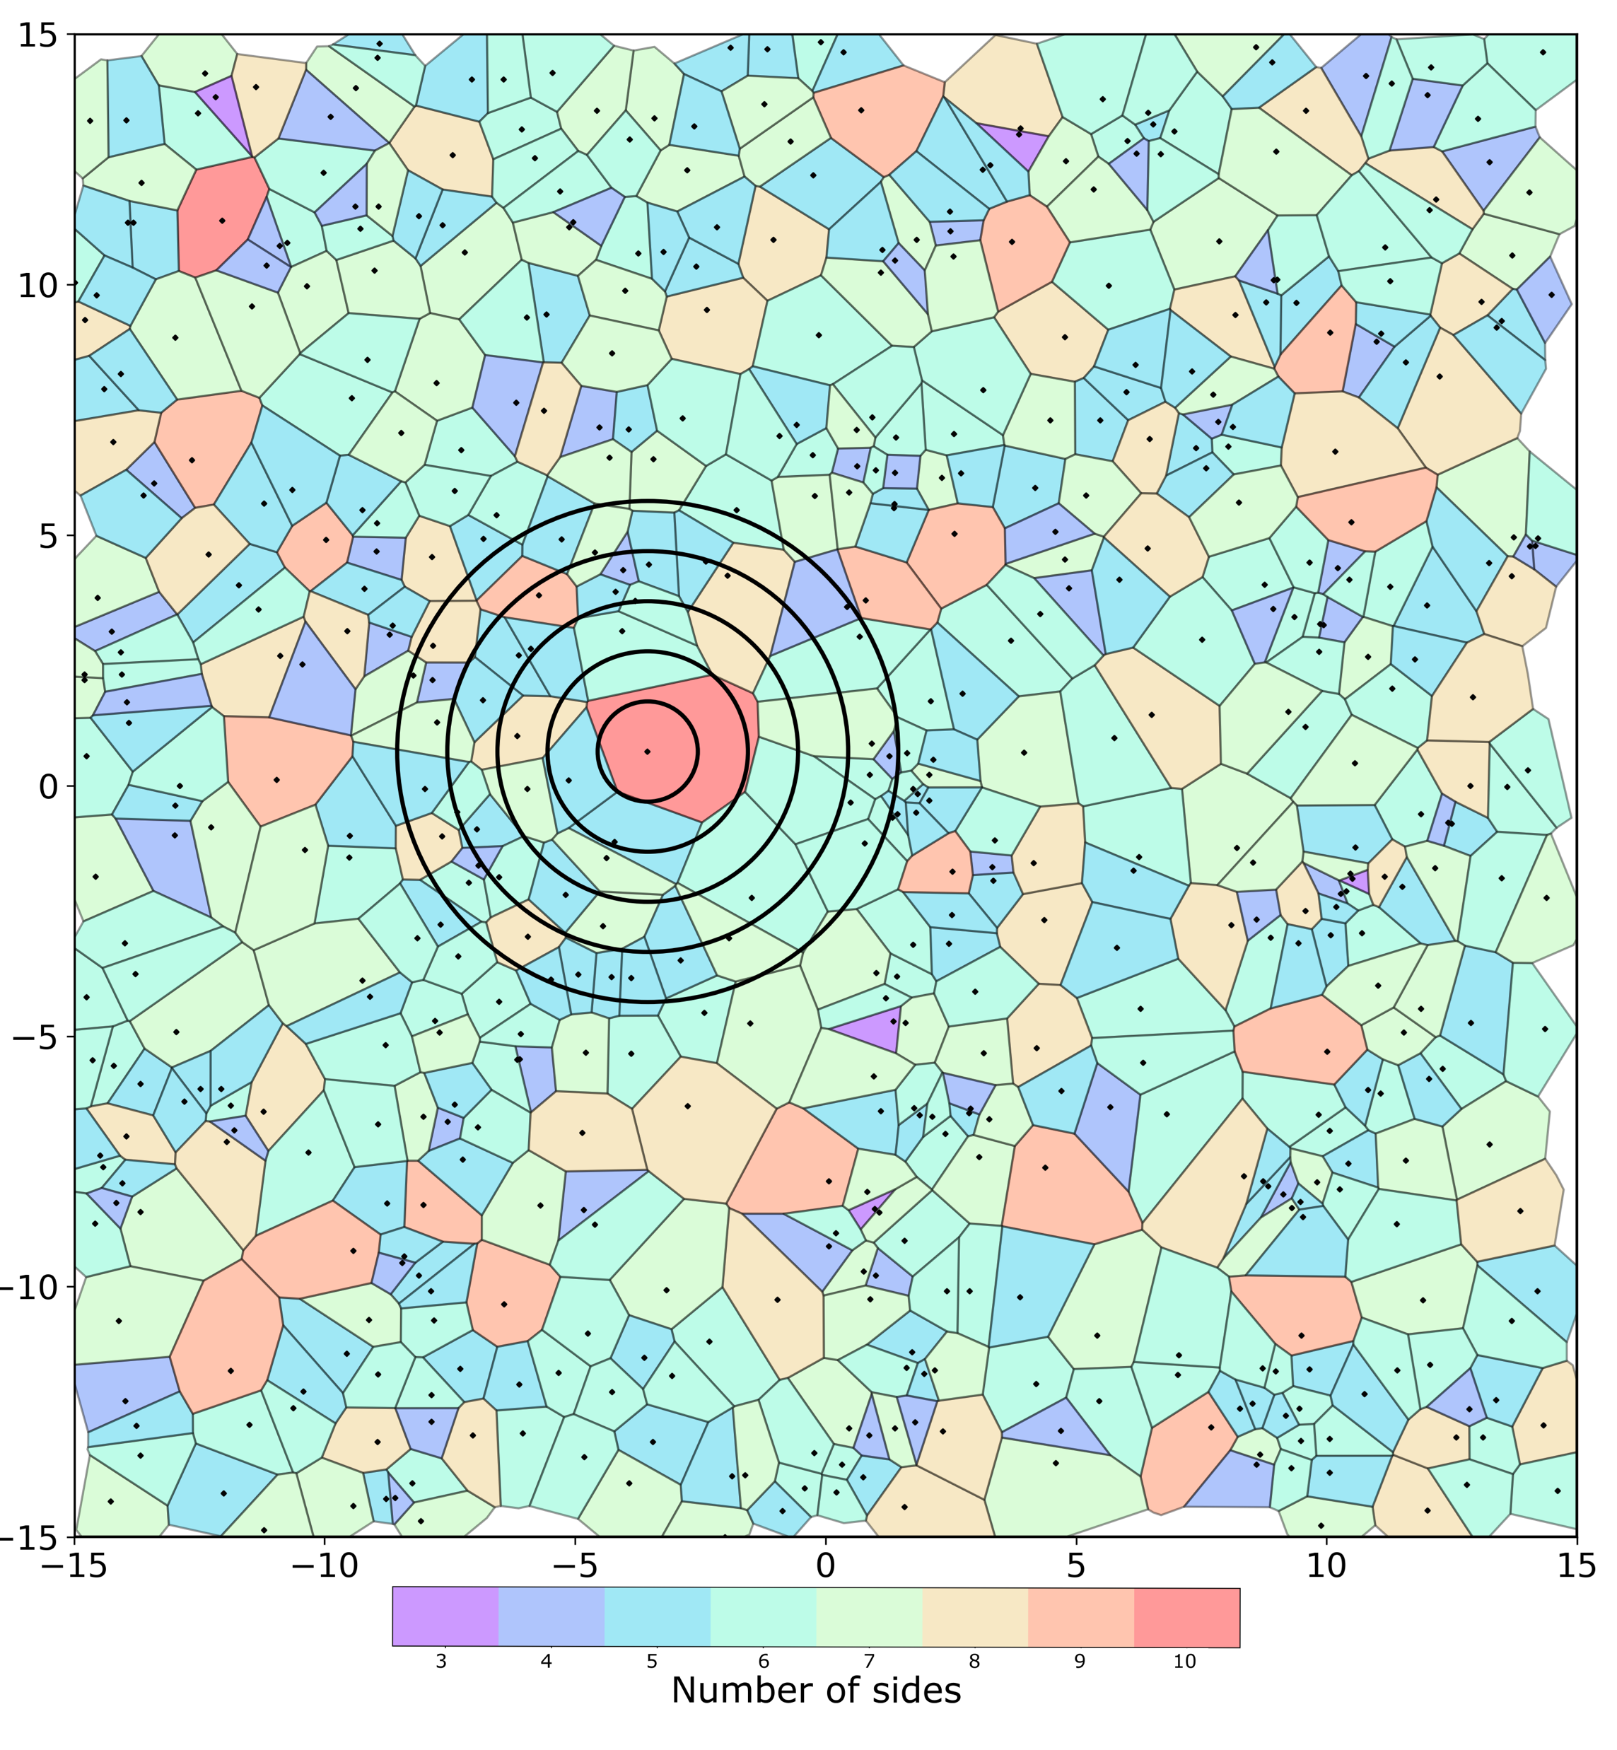
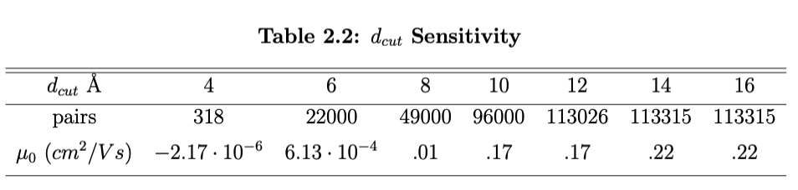
Voronoi Tessellation

Slide 17
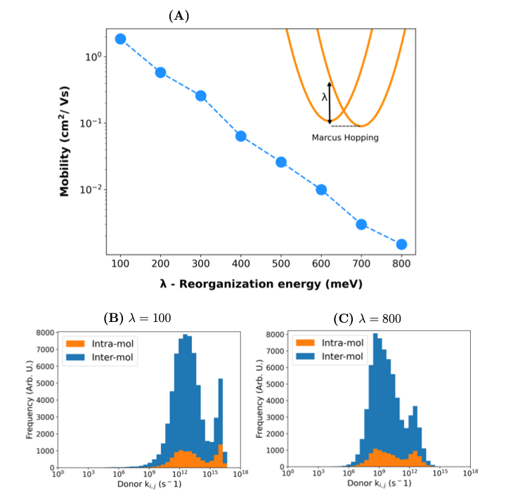

Slide 18
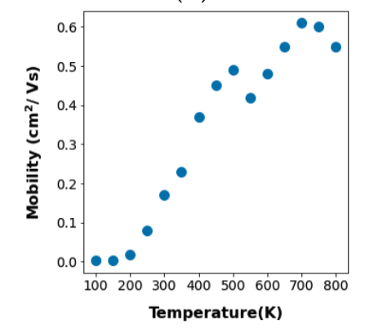
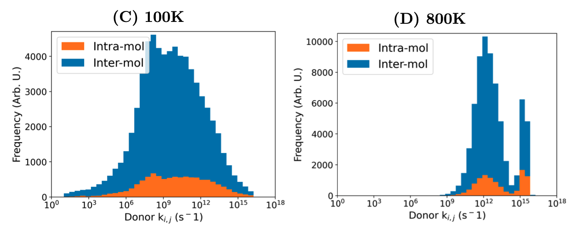

Slide 19
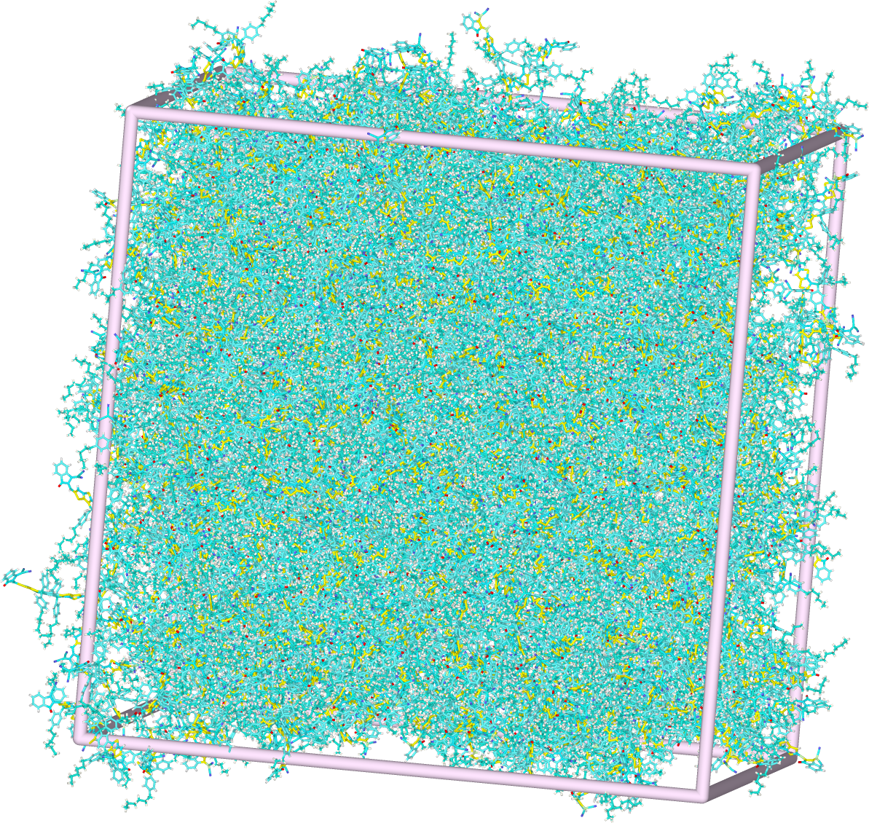
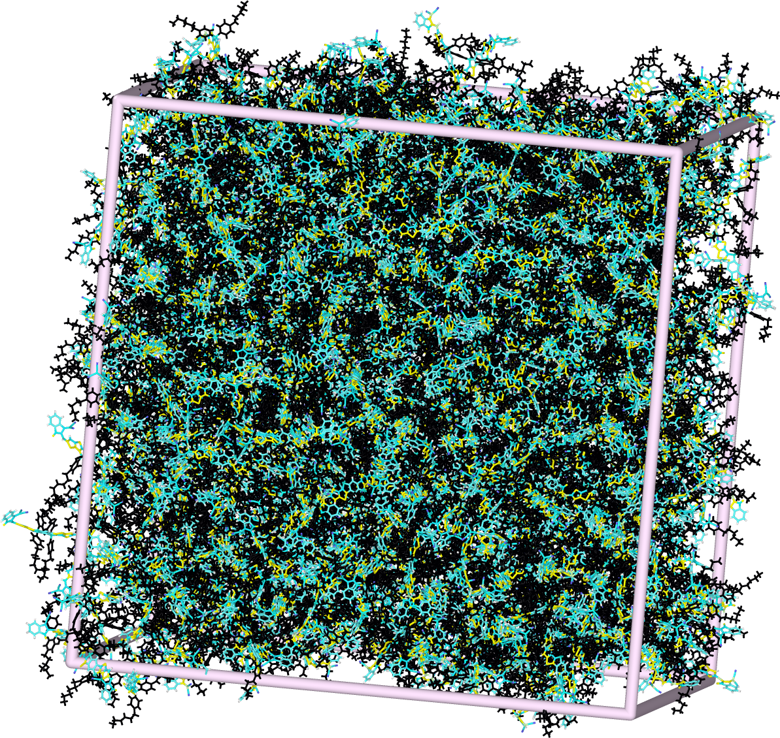
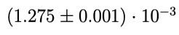
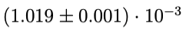
ITIC mobilities
Notes:
The reported experimental electron mobility of ITIC varies depending on how it was processed and how it was measured. Time-of-flight electron mobilities on the order of 10−4 [? ] and field effect mobilities on the order of 10−2 [? ] have been reported. Another computational study, that also used Marcus hopping and kMC, found an electron mobility of 7 · 10−4 [? ] in a pure ITIC crystal.

Slide 20
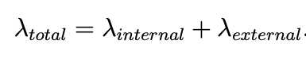
Notes:
The movement of a free charge through a morphology can be modeled as a series of Marcus nonadiabatic electron transfer reactions, or ‘hops’ between relatively weakly interacting chromophores in the system.

